Slide 1
AVR Interfacing IO Ports

Slide 2
Agenda
I/O Ports.
I/O Ports Programming.
Interfacing with Switches and Leds.
Interfacing with 7-Segment.
Interfacing with DC-Motor.
Interfacing with LCD.
Interfacing with Keypad.

Slide 3
I/O Ports
ATmega328p has programmable I/O lines divided into:
ADC 7:6
PORTB(PB7….…..PB0)
PORTC(PC6….…..PC0)
PORTD(PD7……..PD0)
Each PORT is controlled by 3 registers:
DDRx :
Data Direction Register to set the pin either output or input pin.
PORTx
Output Register to assign a value to the port (from µC to interface).
PINx:
Input Register where it holds the input value from interface.
Note: Most pins in µC make more than one function (multiplexed functions)

Slide 4
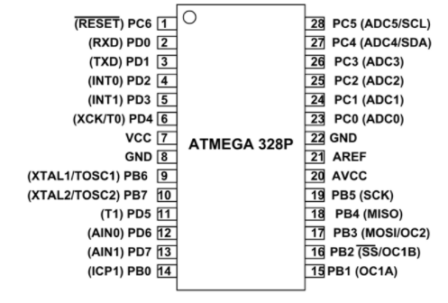
I/O Ports

Slide 5
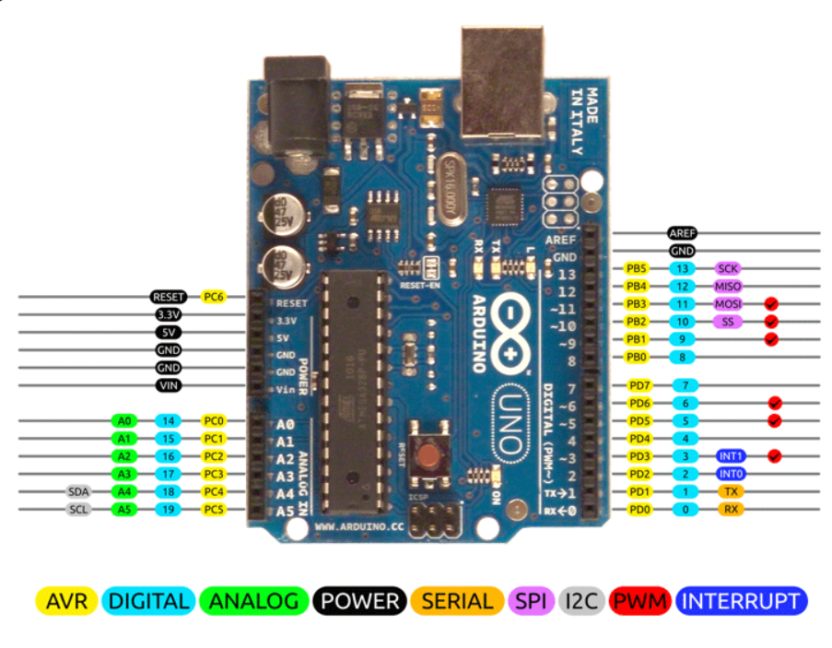
I/O Ports

Slide 6
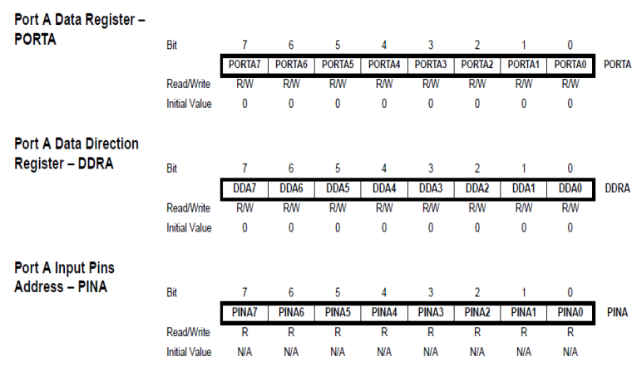
I/O Ports

Slide 7
I/O Ports Programming
To decided which Port is input and which is output:
Configure the port direction use register DDRX 1 → for Output. 0 → for Input.
To Read(input case) :
Use register PINx
To Write(output case) :
Use register PORTx.
Note:
In case you set any PIN as input you can activate the internal pull up resistor by setting the corresponding bit in PORTX register.

Slide 8
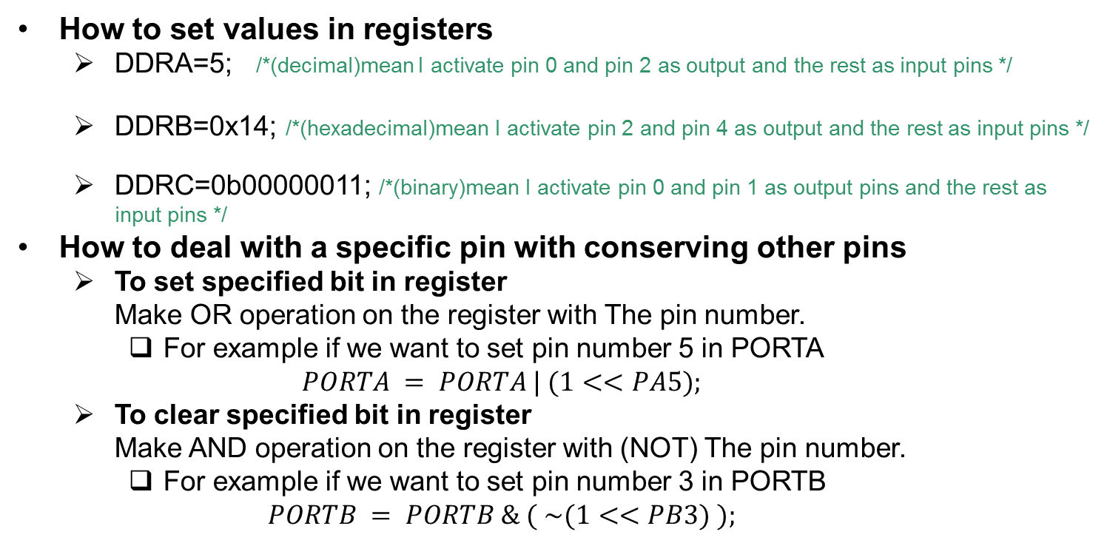
I/O Ports Programming
How to set values in registers
DDRA=5; /*(decimal)mean I activate pin 0 and pin 2 as output and the rest as input pins */
DDRB=0x14; /*(hexadecimal)mean I activate pin 2 and pin 4 as output and the rest as input pins */
DDRC=0b00000011; /*(binary)mean I activate pin 0 and pin 1 as output pins and the rest as input pins */
How to deal with a specific pin with conserving other pins
To set specified bit in register Make OR operation on the register with The pin number.
For example if we want to set pin number 5 in PORTA $PORTA = PORTA | (1<<PA5);$
To clear specified bit in register Make AND operation on the register with (NOT) The pin number.
For example if we want to set pin number 3 in PORTB $PORTB = PORTB \& ( \sim (1<<PB3) );$

Slide 9
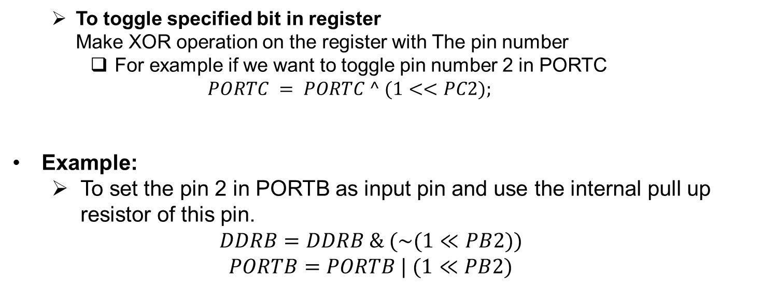
I/O Ports Programming
To toggle specified bit in register Make XOR operation on the register with The pin number
For example if we want to toggle pin number 2 in PORTC $PORTC = PORTC ^ (1<<PC2);$
Example:
To set the pin 2 in PORTB as input pin and use the internal pull up resistor of this pin.
$$DDRB=DDRB \& (\sim (1≪PB2))$$
$$PORTB=PORTB | (1≪PB2)$$

Slide 10
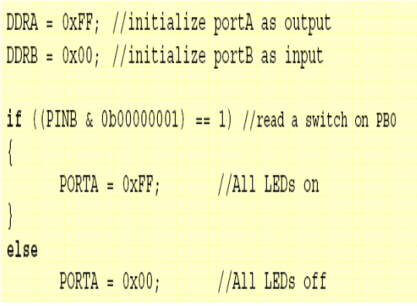
I/O Ports Programming

Slide 11
I/O Ports Programming
I/O Port applications I/O Port applications
As Output • LED and 7-Segemnt • LCD display • Motors. • Buzzer. • Signal to another µC. • Output to PC through PC Serial Port.
As Input • Switches(push button, keypad etc.) • Analog/Digital sensors. • Signal from another µC. • Input from PC through PC Serial Port.

Slide 12
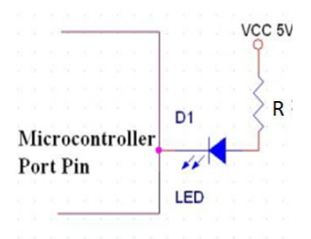
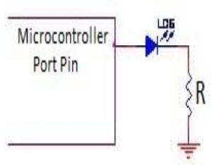
Interfacing with Switches and Leds
I/O Port applications LED Configuration
Negative Logic
Positive Logic

Slide 13
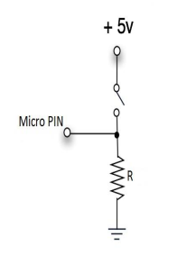
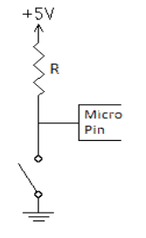
Interfacing with Switches and Leds
I/O Port applications Switch Configuration
Pull Down Resistor
Pull UP Resistor

Slide 14
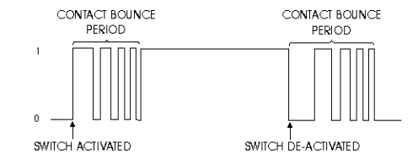
Interfacing with Switches and Leds
I/O Port applications Switch de-bounce problem
Could be handled using software or hardware.
It relies on the fact that bouncing takes a maximum period of 20-30 ms.
The basic idea is to implement a delay after the first detected edge, during which no scanning for the switch is done. after the delay period is finished, scanning can proceed (Exercise 3).

Slide 15
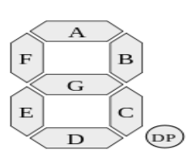
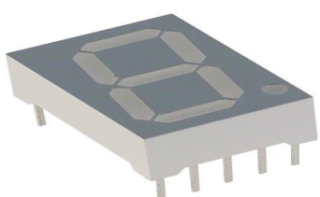
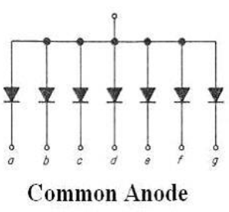
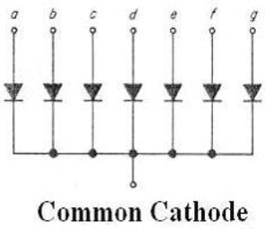
Interfacing with 7-Segment

Slide 16
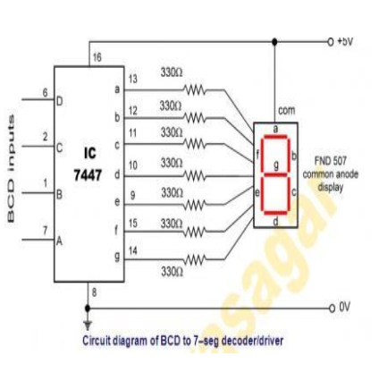
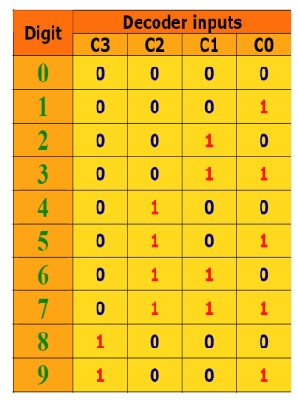
Interfacing with 7-Segment
In order to reduce the number of pins can be used to interface the 7 segment,
we use decoder connected and follows;

